Slide 1
Functions and Control
Structures

Slide 2
Objectives
Using functions to organize PHP code
Variable scope and autoglobal variables
if statements, if...else statements, and switch statements
Nested control structures
while statements, do...while statements, for, and foreach statements
include and require statements

Slide 3
Defining Functions
Functions are groups of statements that you can execute as a single unit
Function definitions are the lines of code that make up a function
The syntax for defining a function is:
  <?php
  function name_of_function(parameters) {
  statements;
  }
  ?>

Slide 4
Defining Functions (continued)
Functions, like all PHP code, must be contained within <?php ... ?> tags
A parameter is a variable that is passed to a function when it is called
Parameters are placed within the parentheses that follow the function name
Functions do not have to contain parameters
The set of curly braces (called function braces) contain the function statements

Slide 5
Defining Functions (continued)
Function statements do the actual work of
the function and must be contained within the
function braces
  function displayCompanyName($Company1, $Company2, $Company3) {
  echo "<p>$Company1</p>";
  echo "<p>$Company2</p>";
  echo "<p>$Company3</p>";
  }

Slide 6
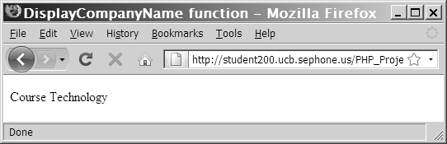
Calling Functions
  function displayCompanyName($CompanyName) {
  echo "<p>$CompanyName</p>";
  }
  displayCompanyName("Course Technology");
Figure 2-1 Output of a call to a custom function

Slide 7
Returning Values
A return statement returns a value to the statement that called the function
Not all functions return values
  $ReturnValue = averageNumbers(1,2,3);
  function averageNumbers($a, $b, $c) {
  $SumOfNumbers = $a + $b + $c;
  $Result = $SumOfNumbers / 3;
  Return $Result;
  }

Slide 8
Returning Values (continued)
You can pass a function parameter by value or by reference
A function parameter that is passed by value is a local copy of the variable.
A function parameter that is passed by reference is a reference to the original variable.

Slide 9
Understanding Variable Scope
Variable scope is where in your program a declared variable can be used
A variable’s scope can be either global or local
A global variable is one that is declared outside a function and is available to all parts of your program
A local variable is declared inside a function and is only available within the function in which it is declared

Slide 10
Global Variables in Functions
$GlobalVariable = “Global Variable”;
  function scopeExample() {
  global $GlobalVariable;
  echo “<p>$GlobalVariable</p>”;
  }
  scopeExample();

Slide 11
Global Variables in Functions
$GlobalVariable = “Global Variable”;
  function scopeExample() {
  echo “<p>”,$GLOBALS[“GlobalVariable”],“</p>”;
  }
  scopeExample();

Slide 12
Using Autoglobals
PHP includes various predefined global arrays, called autoglobals or superglobals
Autoglobals contain client, server, and environment information that you can use in your scripts
Autoglobals are associative arrays – arrays whose elements are referred to with an alphanumeric key instead of an index number

Slide 13
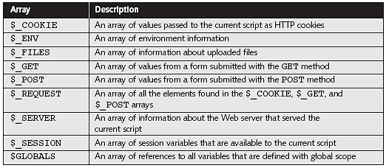
Using Autoglobals (continued)
PHP autoglobals

Slide 14
Using Autoglobals (continued)
$_GET is the default method for submitting a form. $_GET appends form data as one long string to the URL specified by the action attribute
google.com/search?hl=en&source=hp&q=php
$_GET and $_POST allow you to access the values of forms that are submitted to a PHP script

Slide 15
Using Autoglobals (continued)
$_POST sends form data as a transmission separate from the URL specified by the form action attribute
  <form action=“submitpage.php" method=“post">
  <input type="text" name=“variable1">
  <input type="text" name=“variable2">
  <input type="text" name=“name">
  <input type="submit">
  </form>

Slide 16
Autoglobals
$_SERVER[“PHP_SELF”];
$_SERVER[“SERVER_SOFTWARE”];
$_SERVER[“SERVER_PROTOCOL”];
$_GET[“name”];
$_GET[“address”];

Slide 17
Making Decisions
Decision making or flow control is the process of determining the order in which statements execute in a program
The special types of PHP statements used for making decisions are called decision-making statements or decision-making structures

Slide 18
if Statements
Used to execute specific programming code if the evaluation of a conditional expression returns a value of TRUE
The syntax for a simple if statement is:
  if (conditional expression)
  statement;

Slide 19
if Statements (continued)
Contains three parts:
  the keyword if
  a conditional expression enclosed within parentheses
  the executable statements
A command block is a group of statements contained within a set of braces
Each command block must have an opening brace ( { ) and a closing brace ( } )

Slide 20
if Statements (continued)
$ExampleVar = 5;
if ($ExampleVar == 5) { // condition evaluates to 'TRUE'
echo " <p>The condition evaluates to true.</p> ";
echo '<p>$ExampleVar is equal to ',
" $ExampleVar.</p> ";
echo " <p>Each of these lines will be printed.</p> ";
}
echo " <p>This statement always executes after the if
statement.</p> ";

Slide 21
if...else Statements
An if statement that includes an else clause is called an if...else statement
An else clause executes when the condition in an if...else statement evaluates to FALSE
The syntax for an if...else statement is:
if (conditional expression)
statement;
else
statement;

Slide 22
if...else Statements (continued)
An if statement can be constructed without the else clause
The else clause can only be used with an if statement
$Today = " Tuesday ";
if ($Today == " Monday ")
echo " <p>Today is Monday</p> ";
    else
    echo " <p>Today is not Monday</p> ";

Slide 23
Nested if and if...else Statements
When one decision-making statement is contained within another decision-making statement, they are referred to as nested decision-making structures
  if ($SalesTotal >= 50)
  if ($SalesTotal <= 100)
  echo " <p>The sales total is between 50 and 100, inclusive.</p> ";

Slide 24
switch Statements
Control program flow by executing a specific set of statements depending on the value of an expression
Compare the value of an expression to a value contained within a special statement called a case label
A case label is a specific value that contains one or more statements that execute if the value of the case label matches the value of the switch statement’s expression

Slide 25
switch Statements (continued)
Consist of the following components:
  The switch keyword
  An expression
  An opening brace
  One or more case labels
  The executable statements
  The break keyword
  A default label
  A closing brace

Slide 26
switch Statements (continued)
The syntax for the switch statement is:
  switch (expression) {
  case label:
  statement(s);
  break;
  case label:
  statement(s);
  break;
  ...
  default:
  statement(s);
  break;
  }

Slide 27
switch Statements (continued)
A case label consists of:
  The keyword case
  A literal value or variable name
  A colon (:)
A case label can be followed by a single statement or multiple statements
Multiple statements for a case label do not need to be enclosed within a command block

Slide 28
switch Statements (continued)
The default label contains statements that execute when the value returned by the switch statement expression does not match a case label
A default label consists of the keyword default followed by a colon (:)

Slide 29
switch Statements (continued)
$product_name = "Processors";
switch ($product_name)
{
case "Video Cards":
echo "Video cards range from $50 to $500";
break;
case "Processors":
echo “Processors range from $100 to $1000";
break;
default:
echo "Sorry, we don't carry $product_name in our catalog";
break;
}

Slide 30
Repeating Code
A loop statement is a control structure that repeatedly executes a statement or a series of statements while a specific condition is TRUE or until a specific condition becomes TRUE
There are four types of loop statements:
  while statements
  do...while statements
  for statements
  foreach statements

Slide 31
while Statements
Tests the condition prior to executing the series of statements at each iteration of the loop
The syntax for the while statement is:
  while (conditional expression) {
  statement(s);
  }
As long as the conditional expression evaluates to TRUE, the statement or command block that follows executes repeatedly

Slide 32
while Statements (continued)
Each repetition of a looping statement is called an iteration
A while statement keeps repeating until its conditional expression evaluates to FALSE
A counter is a variable that increments or decrements with each iteration of a loop statement

Slide 33
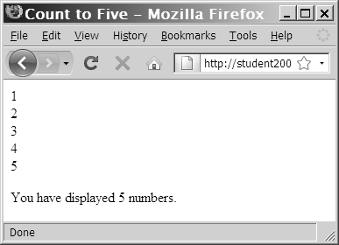
while Statements (continued)
  $Count = 1;
  while ($Count <= 5) {
  echo " $Count<br /> ";
  ++$Count;
  }
  echo " <p>You have printed 5 numbers.</p> ";
Figure 2-5 Output of a while statement using an increment operator

Slide 34
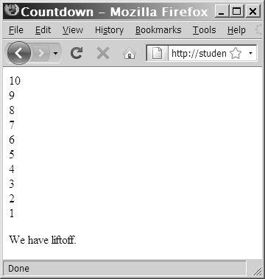
while Statements (continued)
  $Count = 10;
  while ($Count > 0) {
  echo “$Count<br />”;
  --$Count;
  }
  echo " <p>We have liftoff.
  </p> ";
Figure 2-6 Output of a while statement using
a decrement operator

Slide 35
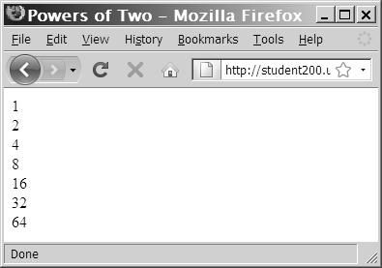
while Statements (continued)
  $Count = 1;
  while ($Count <= 100) {
  echo " $Count<br /> ";
  $Count *= 2;
  }
Figure 2-7 Output of a while statement using the assignment operator *=

Slide 36
while Statements (continued)
In an infinite loop, a loop statement never ends because its conditional expression is never FALSE
  $Count = 1;
  while ($Count <= 10) {
  echo " The number is $Count ";
  }

Slide 37
do...while Statements
Test the condition after executing a series of statements then repeats the execution as long as a given conditional expression evaluates to TRUE
The syntax for the do...while statement is:
do {
statement(s);
    } while (conditional expression);

Slide 38
do...while Statements (continued)
do...while statements always execute once, before a conditional expression is evaluated
  $Count = 2;
  do {
  echo " <p>The count is equal to $Count</p> ";
  ++$Count;
  } while ($Count < 2);

Slide 39
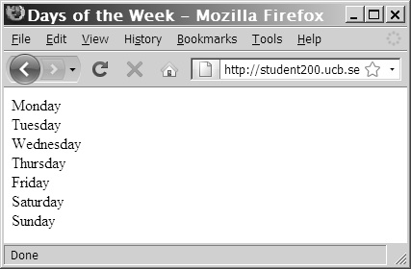
do...while Statements (continued)
$DaysOfWeek = array(" Monday ", " Tuesday ", " Wednesday ", " Thursday ",
" Friday ", " Saturday ", " Sunday ");
$Count = 0;
do {
echo $DaysOfWeek[$Count], "<br />";
++$Count;
} while ($Count < 7);
Figure 2-9 Output of days of week script in Web browser

Slide 40
for Statements
Combine the initialize, conditional evaluation, and update portions of a loop into a single statement
Repeat a statement or a series of statements as long as a given conditional expression evaluates to TRUE
If the conditional expression evaluates to TRUE, the for statement executes and continues to execute repeatedly until the conditional expression evaluates to FALSE

Slide 41
for Statements (continued)
Can also include code that initializes a counter and changes its value with each iteration
The syntax of the for statement is:
for (counter declaration and initialization; condition;
  update statement) {
  statement(s);
  }

Slide 42
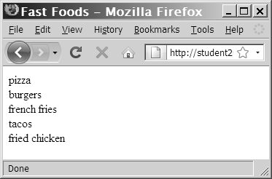
for Statements (continued)
$FastFoods = array(" pizza”, " burgers ", " french fries ", " tacos ", " fried chicken ");
for ($Count = 0; $Count < 5; ++$Count) {
echo $FastFoods[$Count], " <br /> ";
}
Figure 2-10 Output of fast foods script

Slide 43
foreach Statements
Used to iterate or loop through the elements in an array
Do not require a counter; instead, you specify an array expression within a set of parentheses following the foreach keyword
The syntax for the foreach statement is:
  foreach ($array_name as $variable_name) {
  statements;
  }

Slide 44
foreach Statements (continued)
$DaysOfWeek = array(("Monday", "Tuesday", "Wednesday", "Thursday", "Friday", "Saturday", "Sunday");
foreach ($DaysOfWeek as $Day) {
echo "<p>$Day</p>";

Slide 45
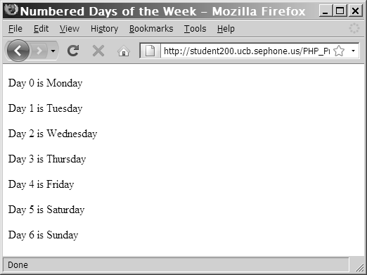
foreach Statements (continued)
$DaysofWeek = array("Monday", "Tuesday", "Wednesday", "Thursday", "Friday", "Saturday", "Sunday");
foreach ($DaysOfWeek as $DayNumber => $Day) {
echo "<p>Day $DayNumber is $Day</p>";
Figure 2-11 Output of the foreach script with index values

Slide 46
Including Files
The include and require statements reuse content by allowing you to insert the content of an external file on multiple Web pages
  The include statement generates a warning if the include file cannot be found
  The require statement halts the processing of the Web page and displays an error if the include file cannot be found
The include_once and require_once statements assure that the external file is added to the script only one time

Slide 47
Summary
Functions are groups of statements that you can execute as a single unit
Autoglobals contain client, server, and environment information that you can use in your scripts
Decision making or flow control is the process of determining the order in which statements execute in a program

Slide 48
Summary
The lines that make up a function are called the function definition
A function parameter that is passed by value is a local copy of the variable
A function parameter that is passed by reference is a reference to the original variable
A global variable is declared outside a function and is available to all parts of your program

Slide 49
Summary (continued)
A local variable is declared inside a function and is only available within the function in which it is declared
The process of determining the order in which statements execute in a program is called decision making or flow control
The if statement is used to execute specific programming code if the evaluation of a conditional expression returns a value of TRUE

Slide 50
Summary (continued)
The if statement is used to execute specific programming code if the evaluation of a conditional expression returns a value of true
An if statement that includes an else clause is called an if...else statement
An else clause executes when the condition in an if...else statement evaluates to false
The switch statement controls program flow by executing a specific set of statements, depending on the value of an expression

Slide 51
Summary (continued)
A while statement repeats a statement or a series of statements as long as a given conditional expression evaluates to true
The do...while statement executes a statement or statements once, then repeats the execution as long as a given conditional expression evaluates to true
The for statement is used for repeating a statement or a series of statements as long as a given conditional expression evaluates to true
The foreach statement is used to iterate or loop through the elements in an array

Slide 52
Summary (continued)
The include, require, include_once, and require_once statements insert the contents of an external file at the location of the statement

